Slide 1
Design and Analysis of Algorithms
Recurrences
Exercise

Slide 2
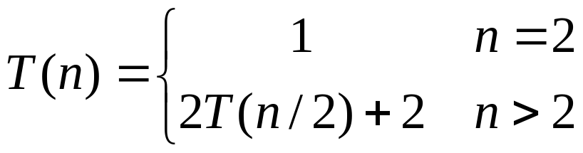

Slide 3
T(n) = 2 + 2T(n/2)
= 2 + 2(2 + 2T(n/2²))
= 2 + 2.2 + 2.2T(n/2²)
= 2 + 2²+ 2²(2+2T (n/2.2²))
= 2+ 2²+2³+2³T(n/2³)
… after k steps, we have
………………
T(n) = 2+ 2²+2³+…+2^{k} + 2^{k}T(n/2^{k})
= 2(2^{k}-1) + n/2T(2) because 2^{k+1}=n
= 2(n/2)-2 + n/2T(2)
= n - 2 + n/2 because T(2)=1
= (3n/2) - 2

